Slide 1
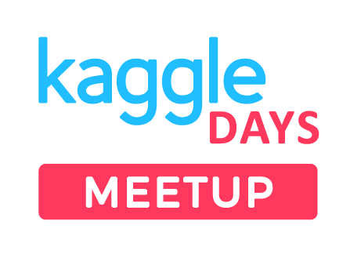




Kaggle Vs Real World Projects
Ankit Rathi
(ankitrathi.com)

Slide 2
AGENDA

Slide 3
About Me
Context Building
Hackathons
Real-World Projects
Head to Head Comparison
General Differences
Q&A

Slide 4
About Me

Slide 5
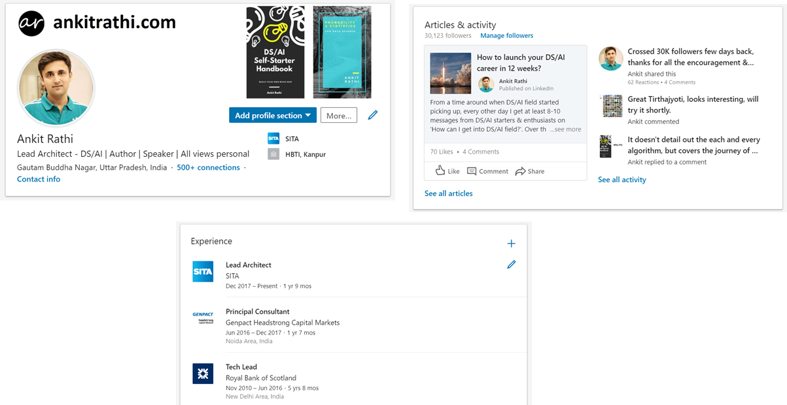

Slide 6
14+ years in Data & Analytics
Currently working in SITA.aero
Worked on DBs/ETL/DWH/BI
Transitioned into DS/AI in 2014
Infusing intelligence in products
Blogger, Author & Speaker

Slide 7
Let me start with a story…

Slide 8
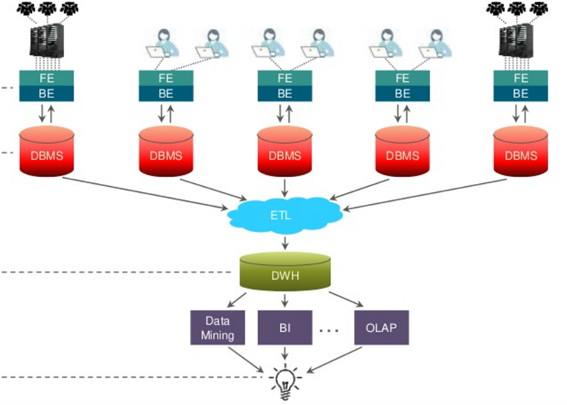

Slide 9
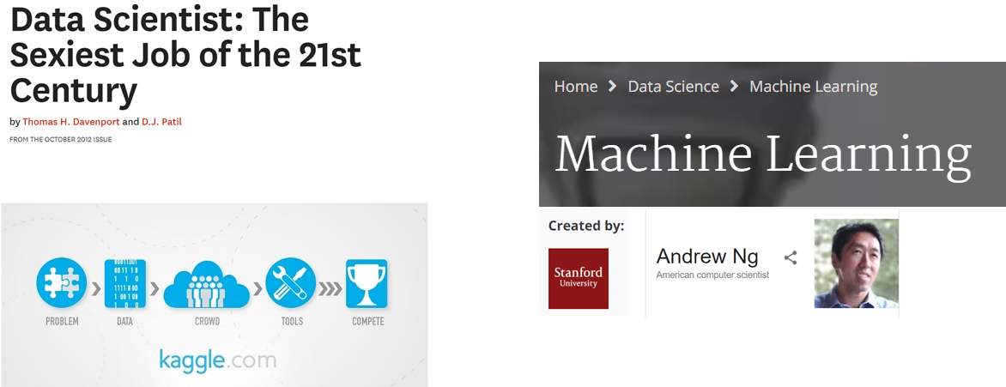

Slide 10
Context Building

Slide 11
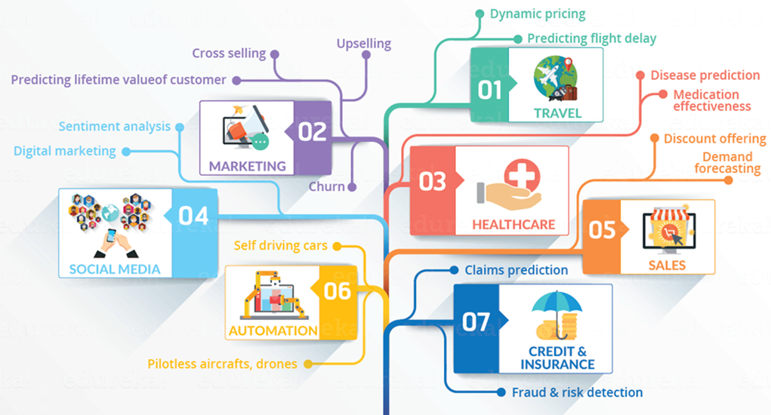

Slide 12
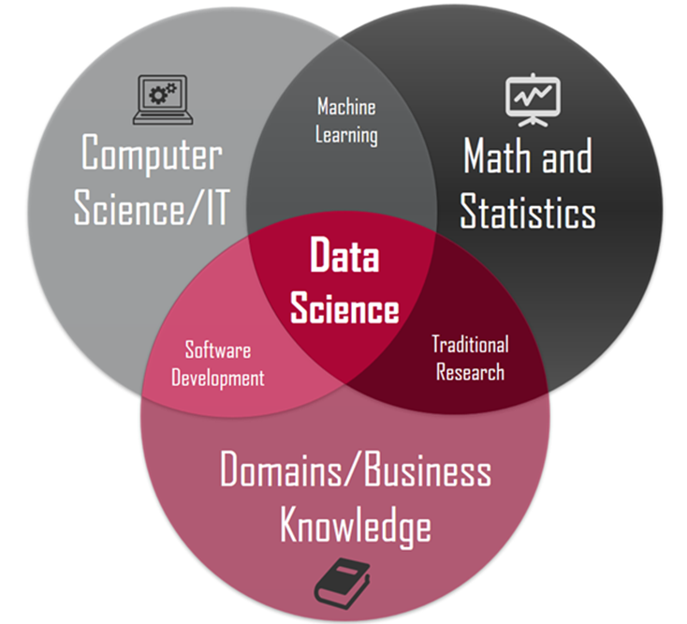

Slide 13
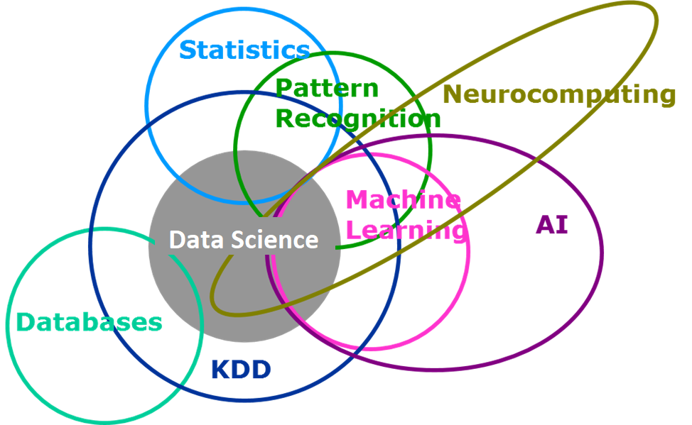

Slide 14
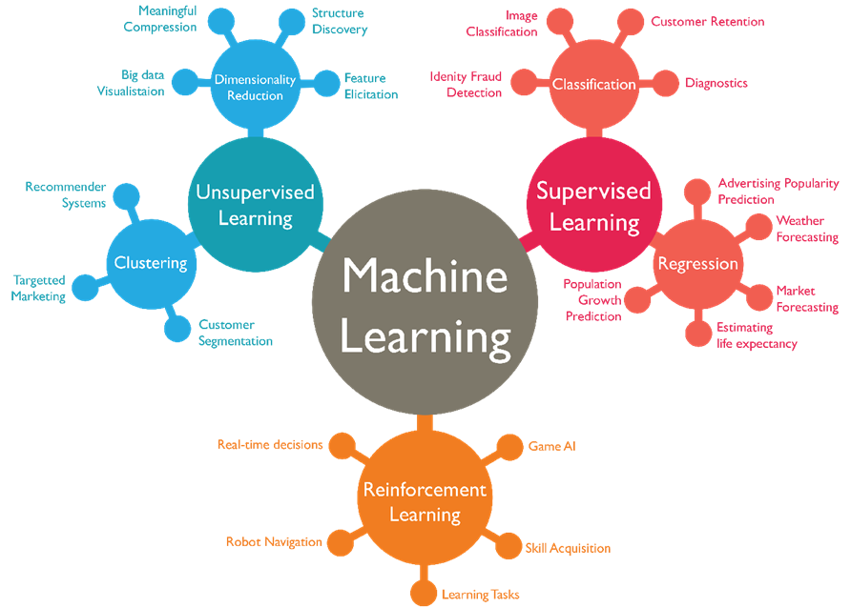

Slide 15
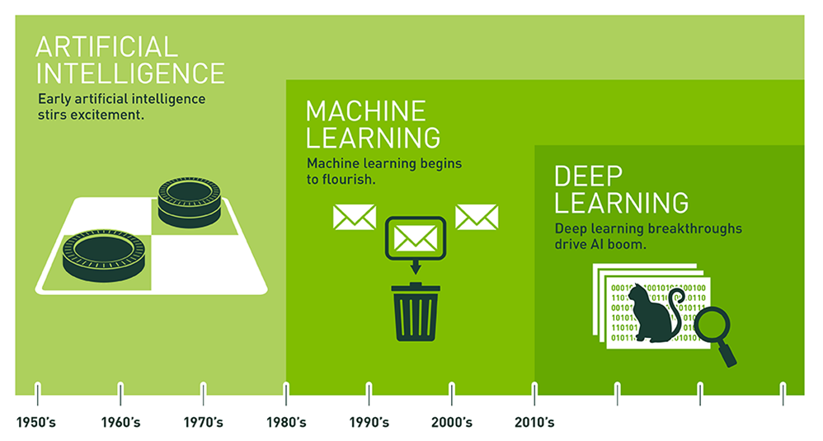

Slide 16
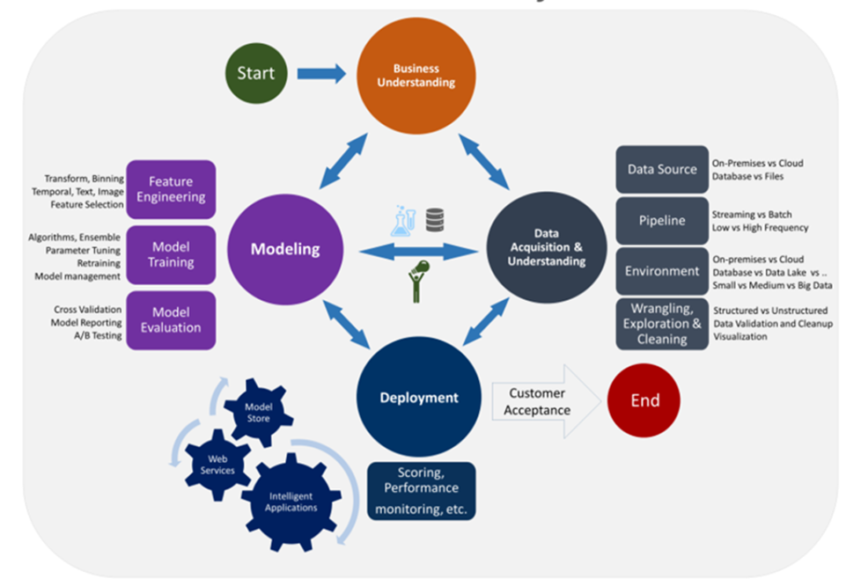

Slide 17
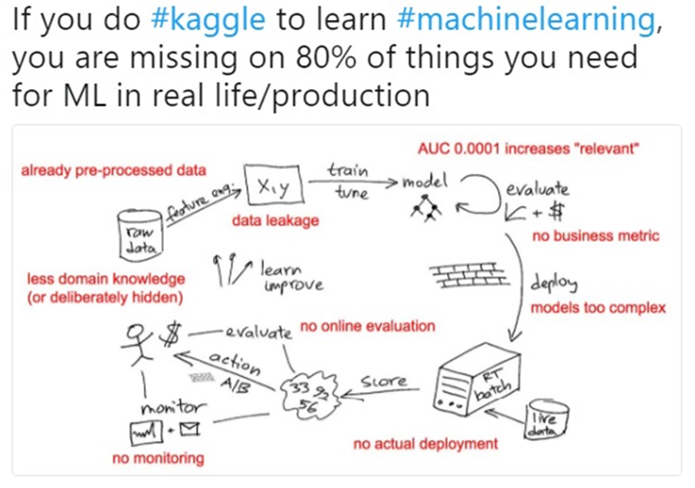

Slide 18
Hackathons

Slide 19
Get the Overview
Description, Evaluation, Timeline, Specific Req.
Explore the data
Explore other kernels
Build a baseline
Keep improvising till deadline

Slide 20
Real World Projects

Slide 21
Identify & evaluate the Opportunity
Develop Business Understanding
Fetch, qualify & analyze available data
Build a Prototype/POC
Follow CRISP-DM methodology
Deploy, Host & Monitor

Slide 22
Head to Head Comparison

Slide 23
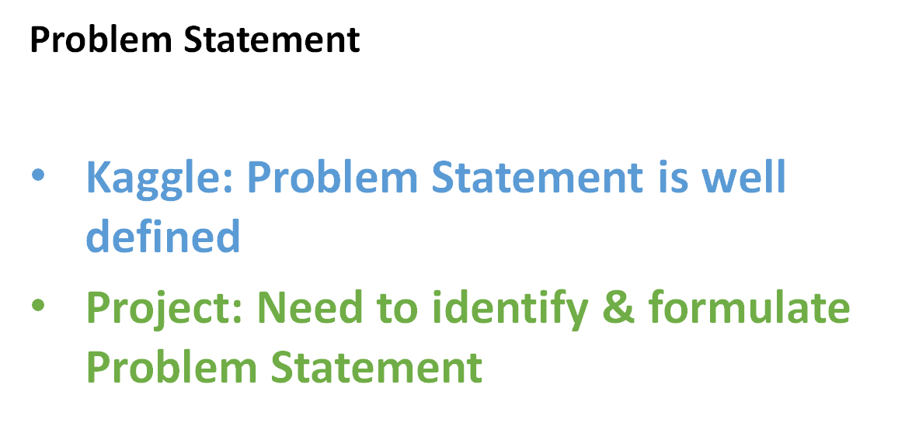

Slide 24
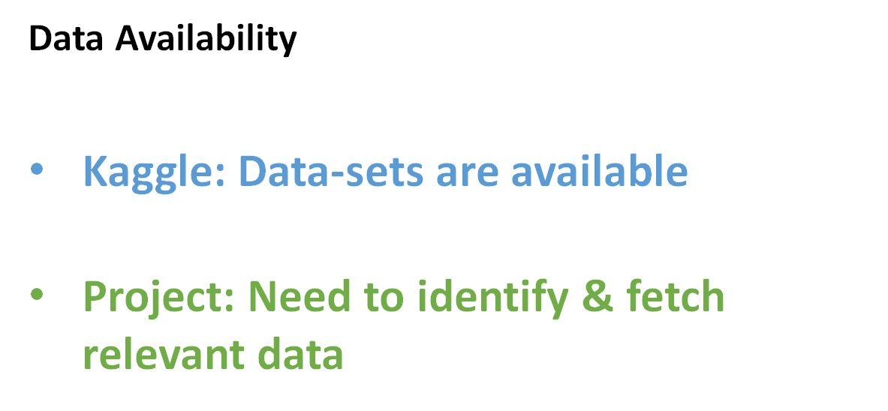

Slide 25
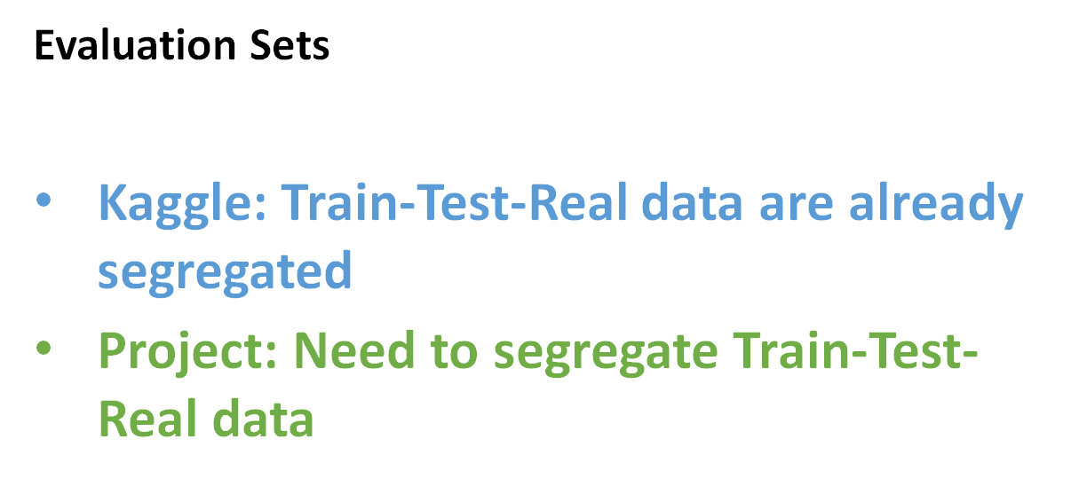

Slide 26
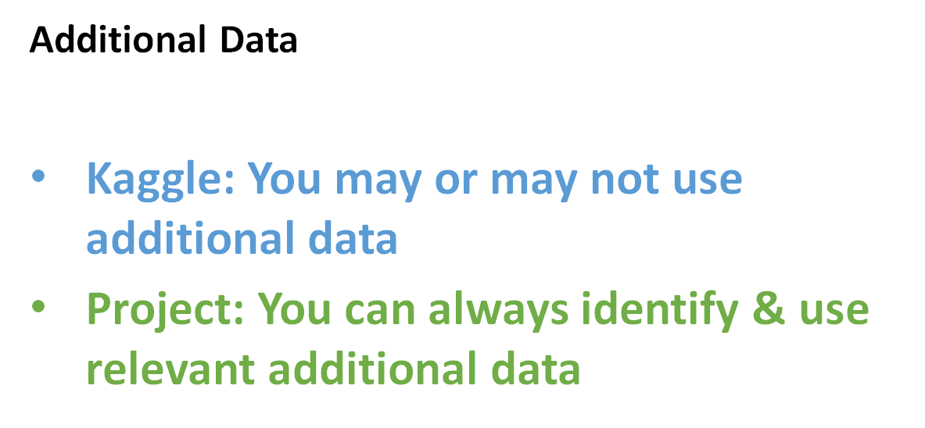

Slide 27
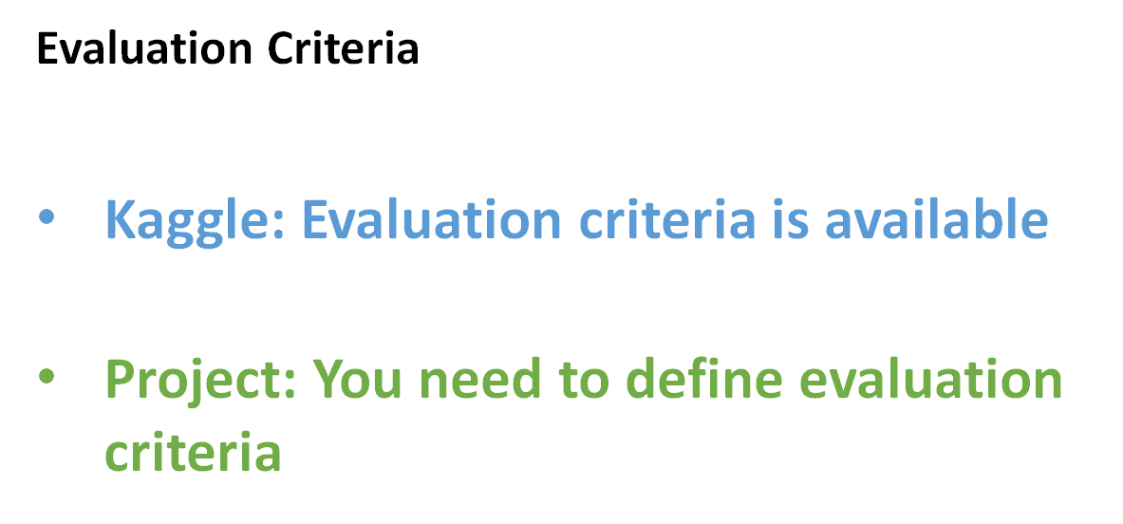

Slide 28
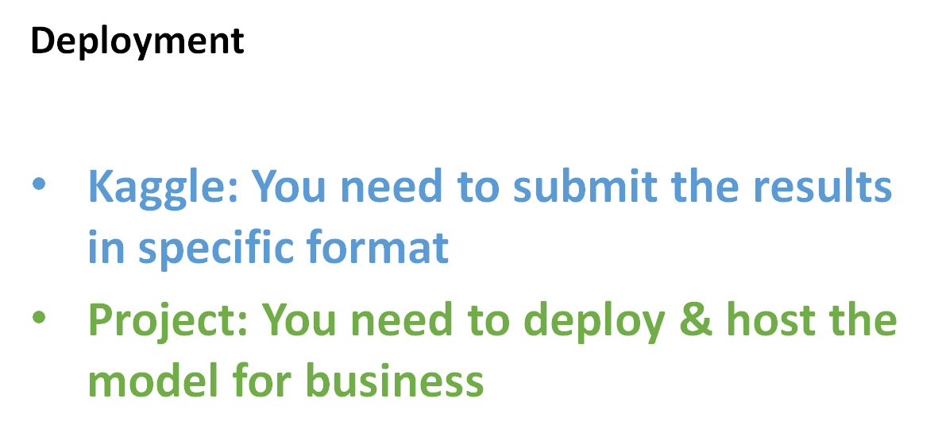

Slide 29
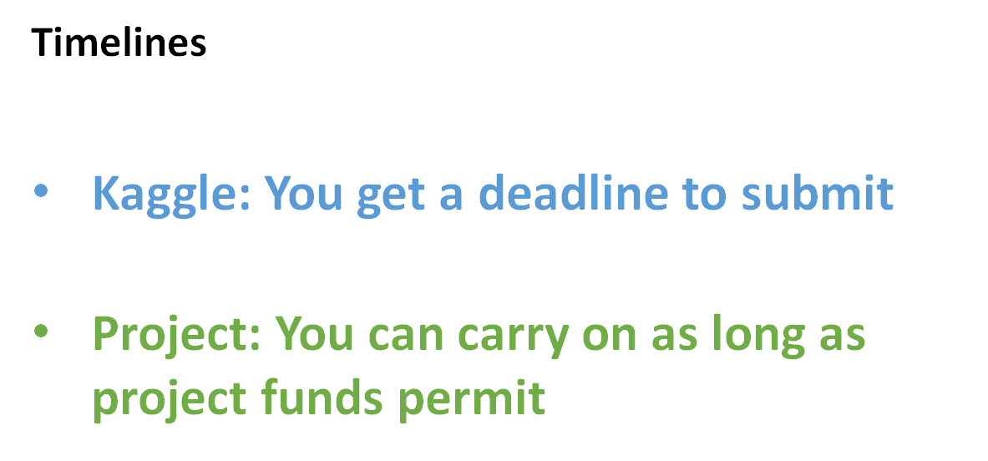

Slide 30
General Differences

Slide 31
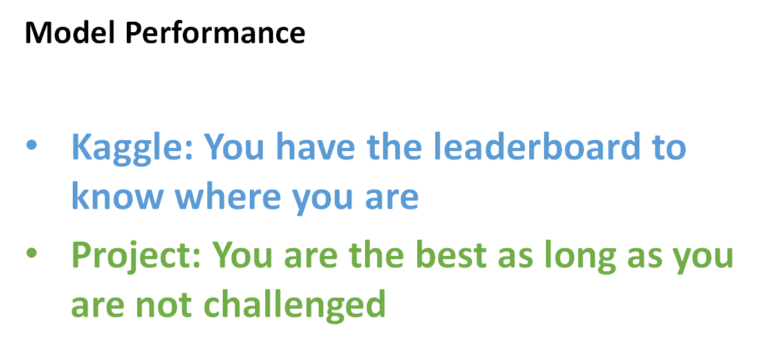

Slide 32
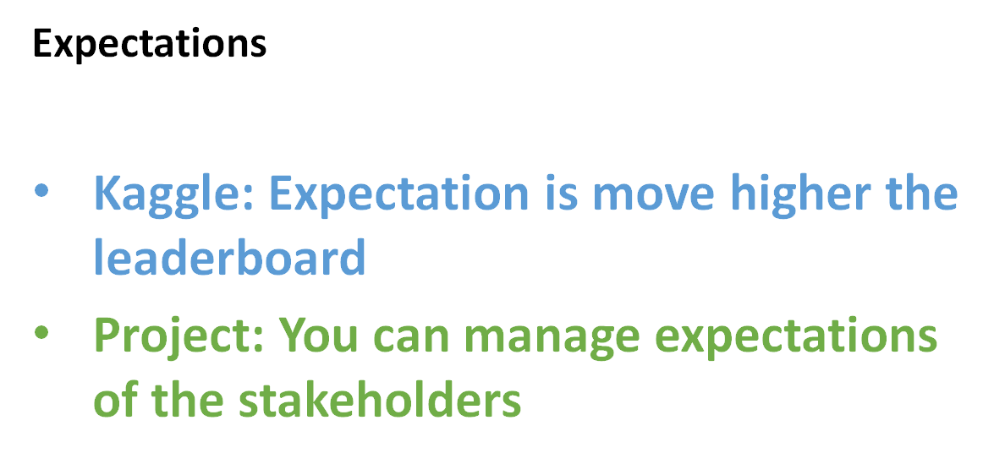

Slide 33
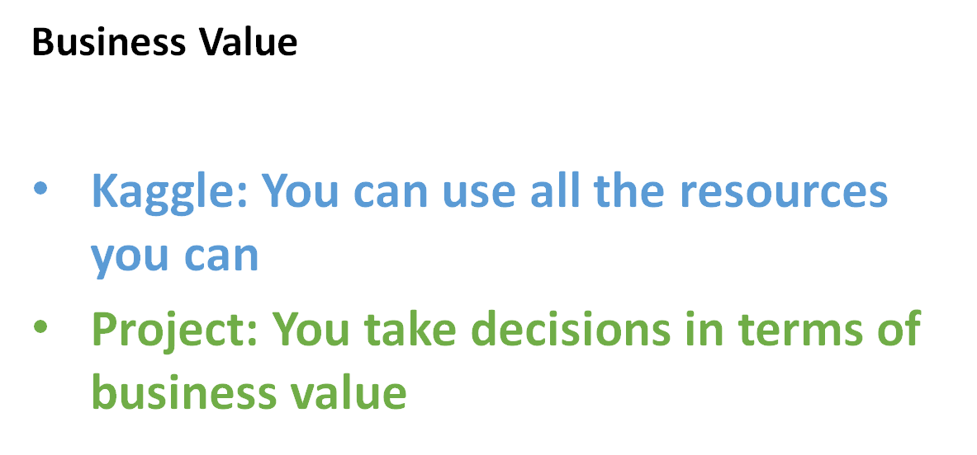

Slide 34
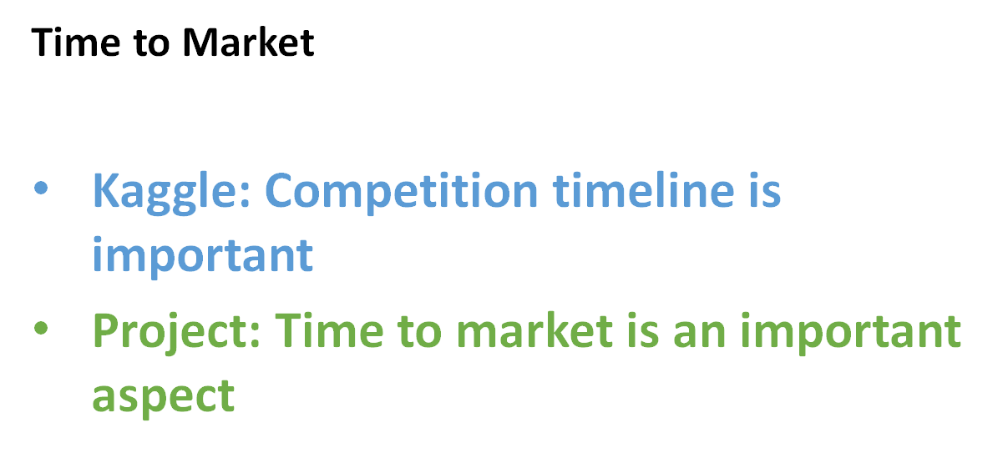

Slide 35
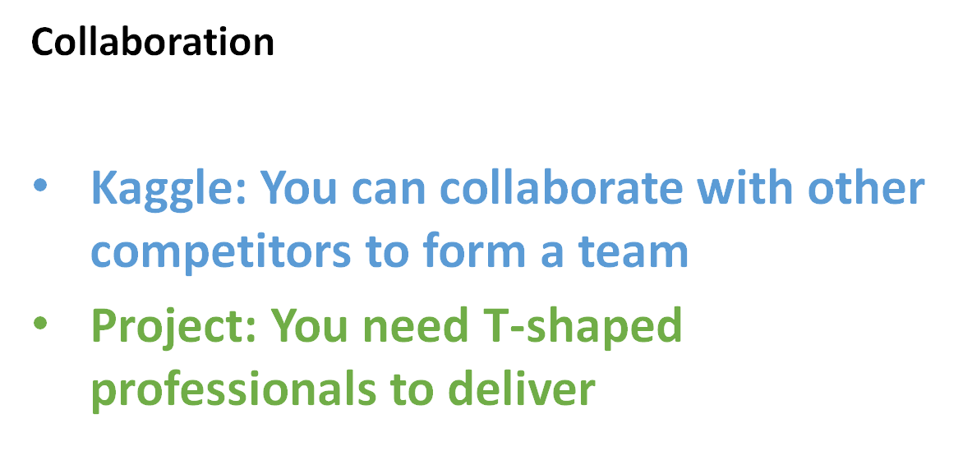

Slide 36
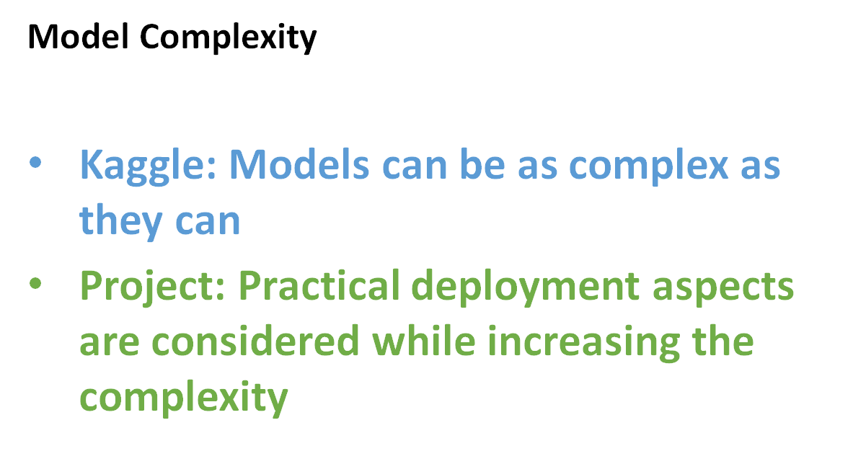

Slide 37
Concluding Thoughts

Slide 38
Q&A

Slide 39
